Slide 1


A Severity Based Analysis of UNOCHA Funding
Lorenzo, Mateusz, Elijah, Simone
Uninformed Priors

Slide 2
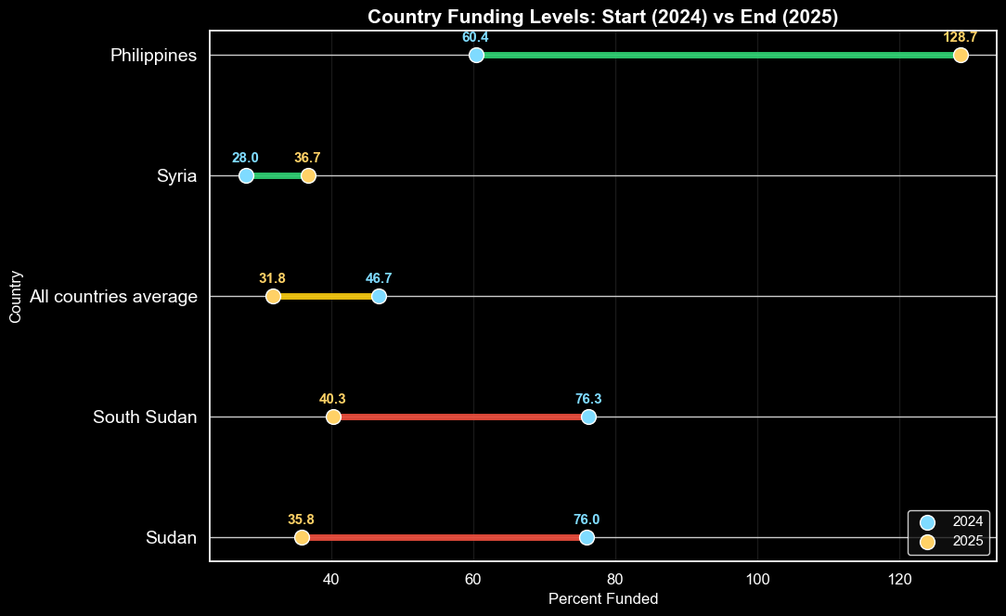
Uninformed Priors

Slide 3
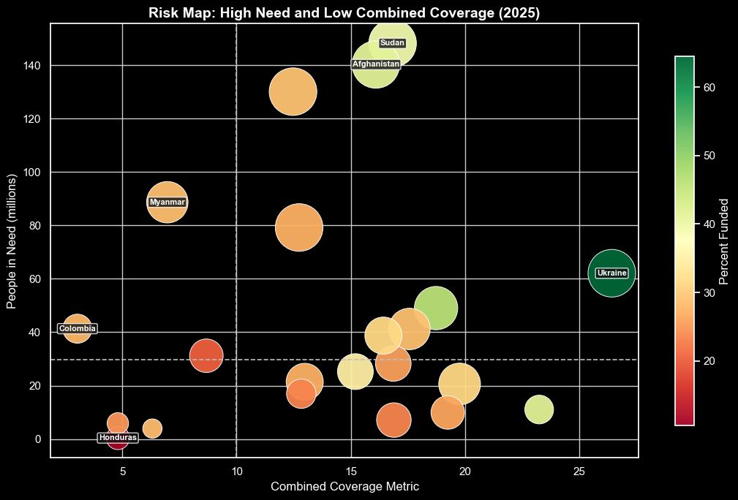
Uninformed Priors

Slide 4
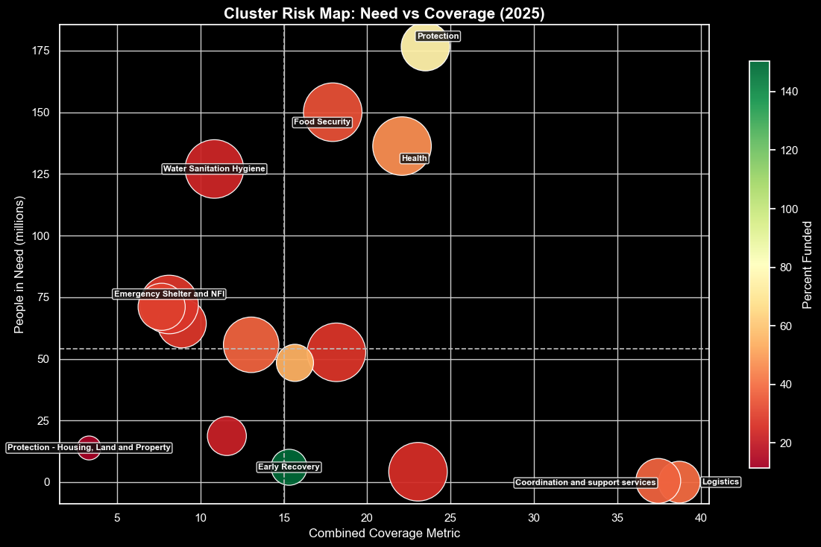
Uninformed Priors

Slide 5
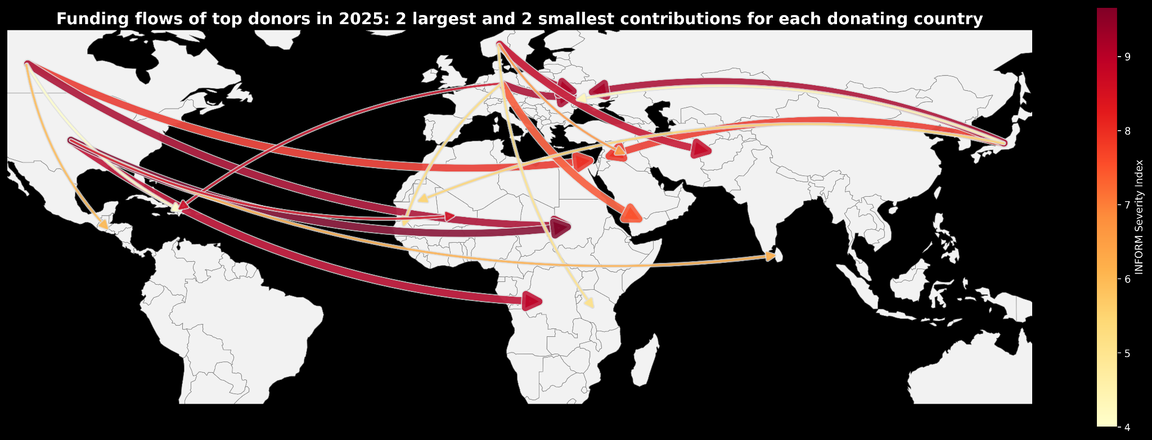
Table: Weighted Average Severity Crisis Level Donated to by five Largest Donors
Japan | USA | Norway | Germany | Canada
7.23 | 7.96 | 8.98 | 8.00 | 7.94
Uninformed Priors

Slide 6
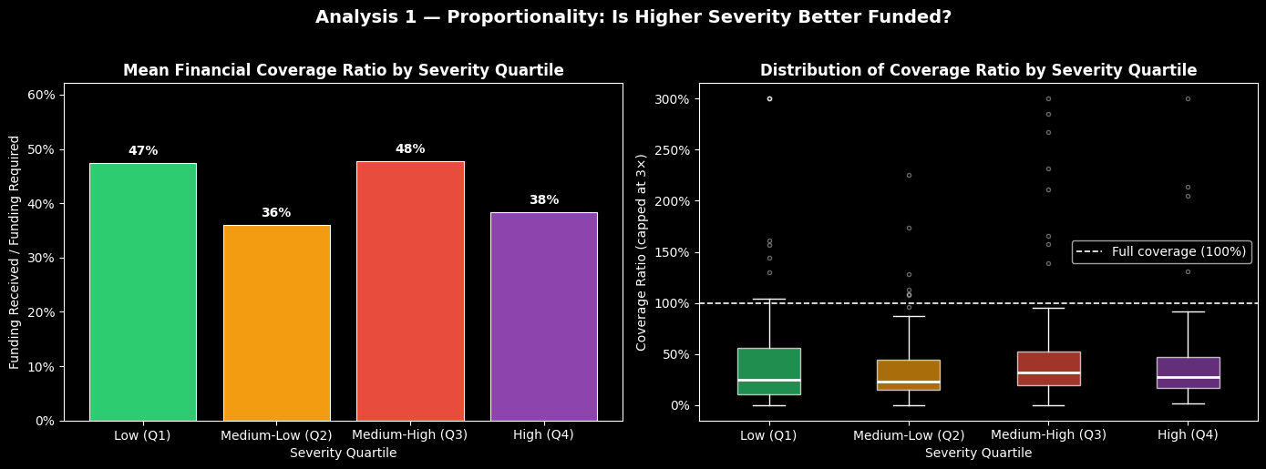
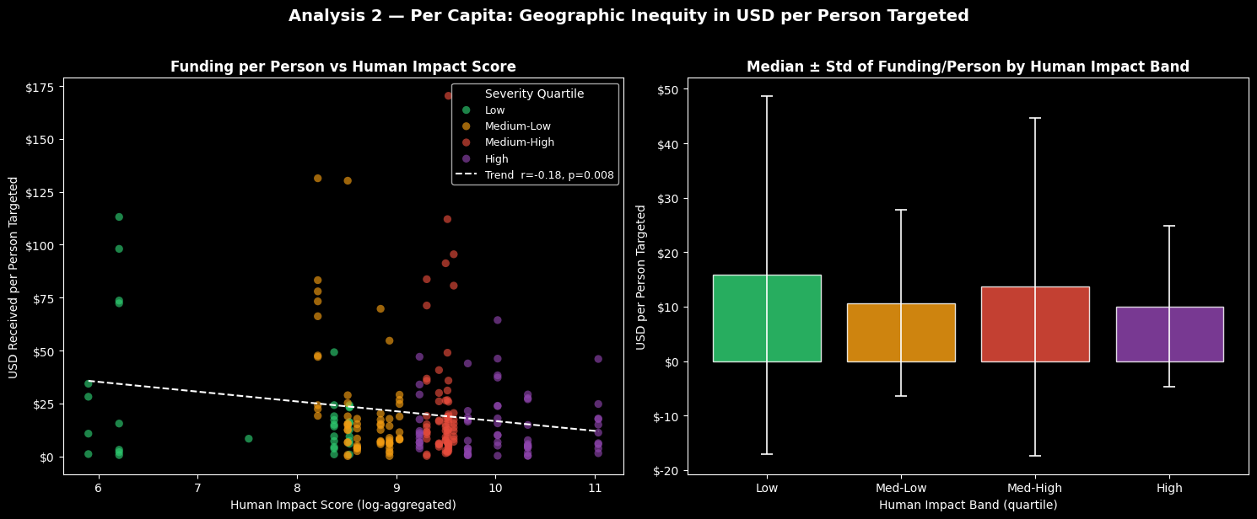
RELATIONSHIP BETWEEN PROJECT FUNDS ALLOCATION AND CRISIS SEVERITY PER COUNTRY
Uninformed Priors

Slide 7
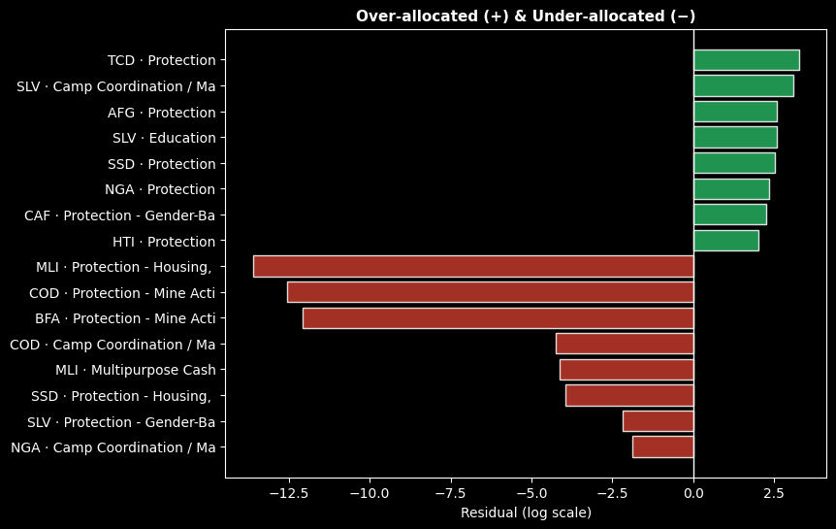
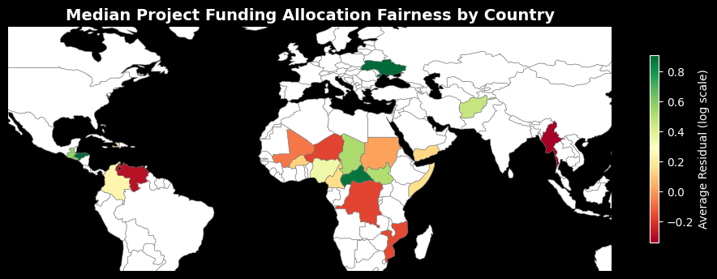
RELATIONSHIP BETWEEN PROJECT FUNDS ALLOCATION AND CRISIS SEVERITY PER COUNTRY
Uninformed Priors

Slide 8
Thank You!
Uninformed Priors

